Slide 1
Final Project Review
Granny Copter
April 24, 2017
Advisor: Weibo Gong
Notes:
‹#›
‹#›
‹#›
‹#›

Slide 2



Granny Copter
Timothy MacMannis
CSE
Peter May
CSE
Noah Smith
EE
Zachary Roy
EE
Advisor: Weibo Gong
Notes:
‹#›
‹#›
‹#›
‹#›

Slide 3
Project Overview
Use a drone to access objects on the ground
Employ granular jamming to pick up objects of different shapes and orientations
Automatically navigate to objects using advanced sensor and software techniques
Advisor: Weibo Gong
Notes:
Zach

Slide 4
Project Specifications
Find and fly to objects autonomously
Pick up complex shapes
Able to lift up to 5lbs
20 minute flight time
Durable frame
Less than $500
Advisor: Weibo Gong
Notes:
6 min

Slide 5
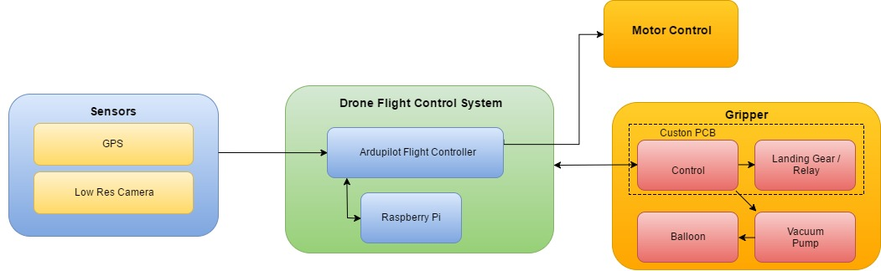
Block Diagram
Notes:
Pete

Slide 6
FPR Deliverables
Replace landing gear servos
Finish autonomous navigation using visual target
Combine gripper and automation system
Advisor: Weibo Gong
Notes:
Pete

Slide 7
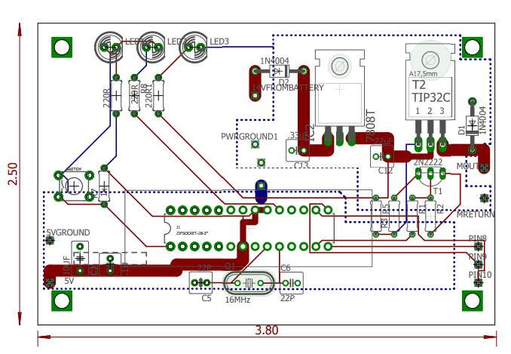
PCB Layout

Slide 8
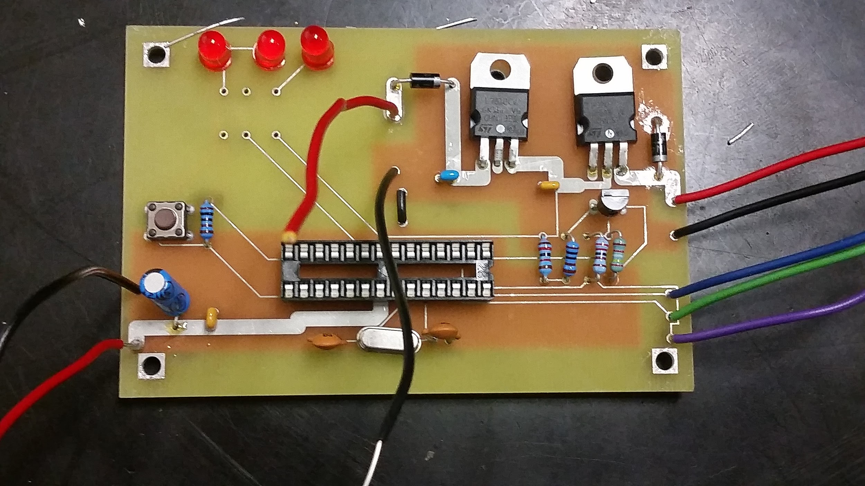
PCB
12V Regulator
Vacuum Switch
Reset
Microcontroller

Slide 9
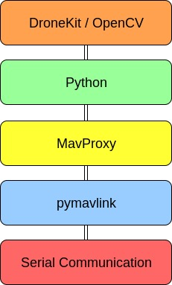
Communication and Interfaces

Slide 10
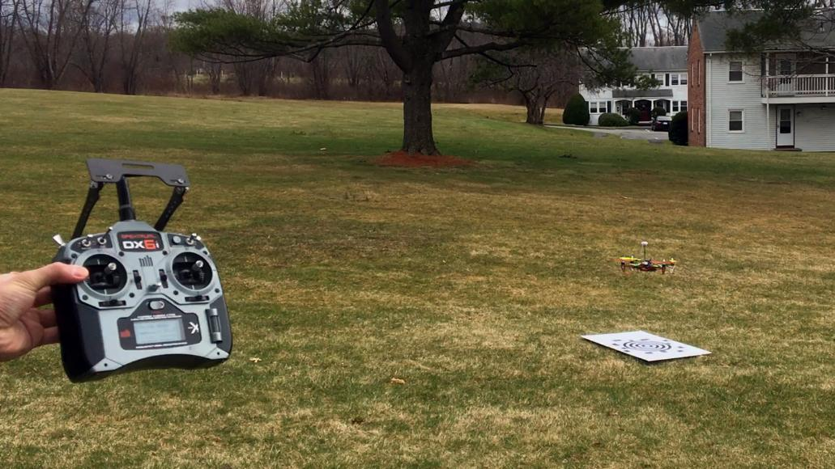
Autonomous Flight
Auto takeoff
GPS Waypoints
Precision Landing
Return to Launch
Notes:
Pete

Slide 11
Cost
Part | Development | Production(1000)
Drone -Motors -Hexa-copter Frame -Speed Controller -Propellers | $223.23 | $167
Gripper | $13.34 | $5
Raspberry Pi 3 Model B | $39.99 | $37
PCB | $70.00 | $10
Notes:
Pete

Slide 12
Cost
Pixhawk Flight Controller | Donated | $70
Landing Gear | $35.34 | $24
12V Vacuum | $21.95 | $16
14V Battery(4s Lipo) | $33.44 | $26
GPS | Donated | $30
Kingmak Mini HD Camera | $16.99 | $12
Relay Switch | $12.65 | $9
Total | $466.93 | $406
Notes:
Pete

Slide 13
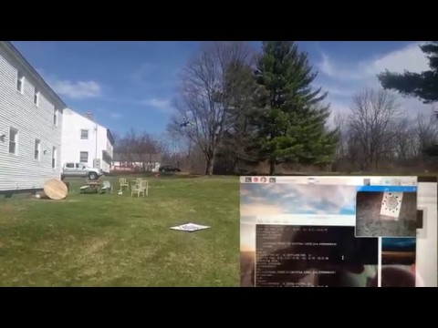
Vision Guided Landing
Advisor: Weibo Gong
Notes:
Pete

Slide 14
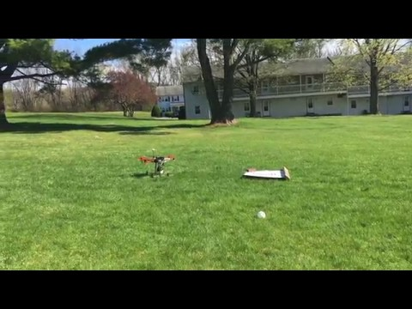
GPS Guided Landing
Advisor: Weibo Gong
Notes:
Pete

Slide 15
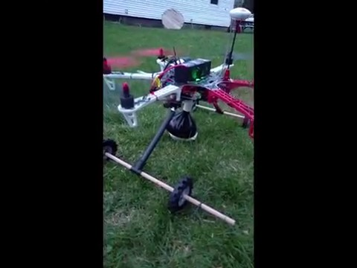
Manual Object Pickup
Advisor: Weibo Gong
Notes:
Pete

Slide 16

Questions or Comments?
Advisor: Weibo Gong

